Slide 1

Phenotype-Genotype Branch-Site Model Users Tutorial Version 1.00
By C T Jones, May 2020
cjones2@dal.ca

Slide 2
System Requirements
The PG-BSM is currently available on in Matlab code only. The code requires a licensed version of Matlab installed on your computer, and makes use of the Statistics Toolbox, the Optimization Toolbox, and the Distributed Computing Toolbox. Type ver at the Matlab command line to see the toolboxes installed on your computer.
Here is the full list of the toolboxes installed on the computer used to develop the PG-BSM.
>> ver
-----------------------------------------------------------------------------------------------------
MATLAB Version: 9.7.0.1216025 (R2019b) Update 1
-----------------------------------------------------------------------------------------------------
MATLAB Version 9.7 (R2019b)
Simulink Version 10.0 (R2019b)
Curve Fitting Toolbox Version 3.5.10 (R2019b)
Global Optimization Toolbox Version 4.2 (R2019b)
MATLAB Coder Version 4.3 (R2019b)
MATLAB Compiler Version 7.1 (R2019b)
MATLAB Compiler SDK Version 6.7 (R2019b)
Optimization Toolbox Version 8.4 (R2019b)
Parallel Computing Toolbox Version 7.1 (R2019b)
Statistics and Machine Learning Toolbox Version 11.6 (R2019b)
Symbolic Math Toolbox Version 8.4 (R2019b)
NOTE: The PG-BSM code was updated and tested by the developer (C. T. Jones) at the time of the writing of this document (August 2020) but has not been tested by other users. Unforeseen issues may therefore arise, and if they do please contact Dr. Jones at cjones2@dal.ca. Also, we are uncertain about the limitations of the model in terms of data complexity. The PG-BSM works well when the phenotype changed on only a few internal branches of the tree but may not do so when the phenotype changed many times and/or when some changes result in ambiguities (e.g., reversions, parallel evolution etc.).

Slide 3
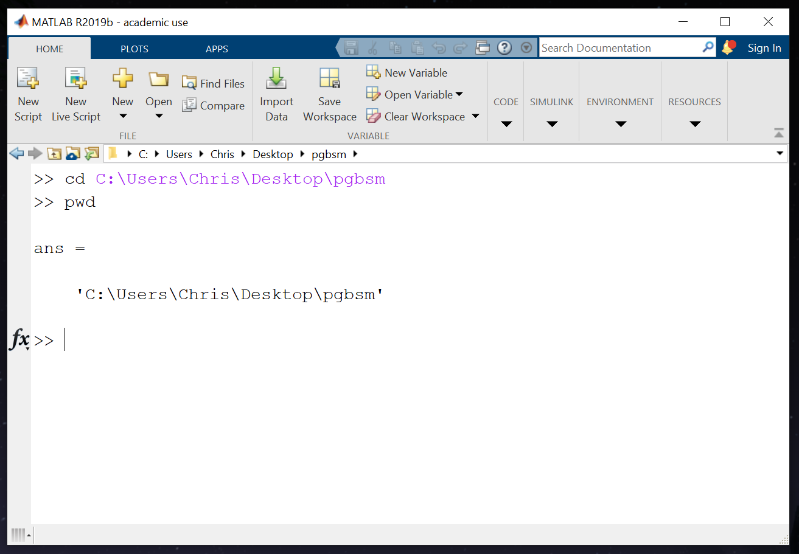
Getting Started
Open Matlab and at the prompt change the current directory to the location of the pgbsm folder on your computer.
For example, my copy of the pgbsm folder is on my desktop:
This is the first step every time you start a new Matlab session to use the PG-BSM code.

Slide 4
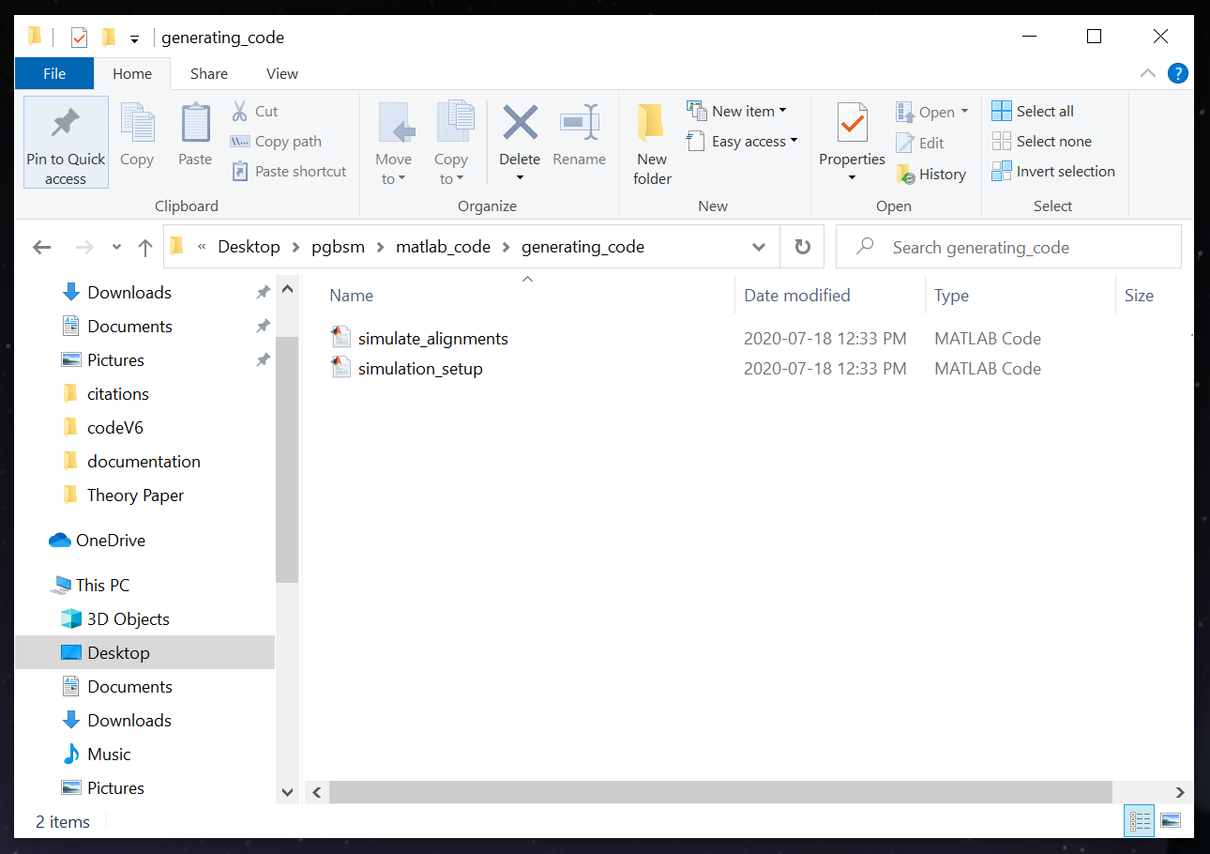
Generating Simulated Alignments
Let us start by simulating some alignments.
Go into your pgbsm folder and find the folder called generating_code.

Slide 5
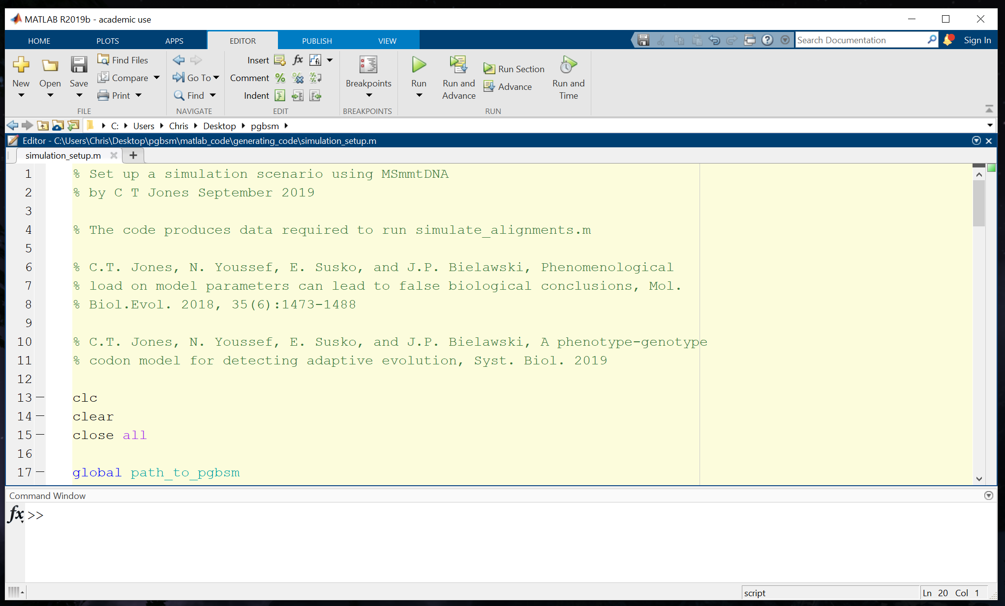
Generating Simulated Alignments
Right click on the Matlab script simulation_setup.m to open it in your Matlab window.

Slide 6
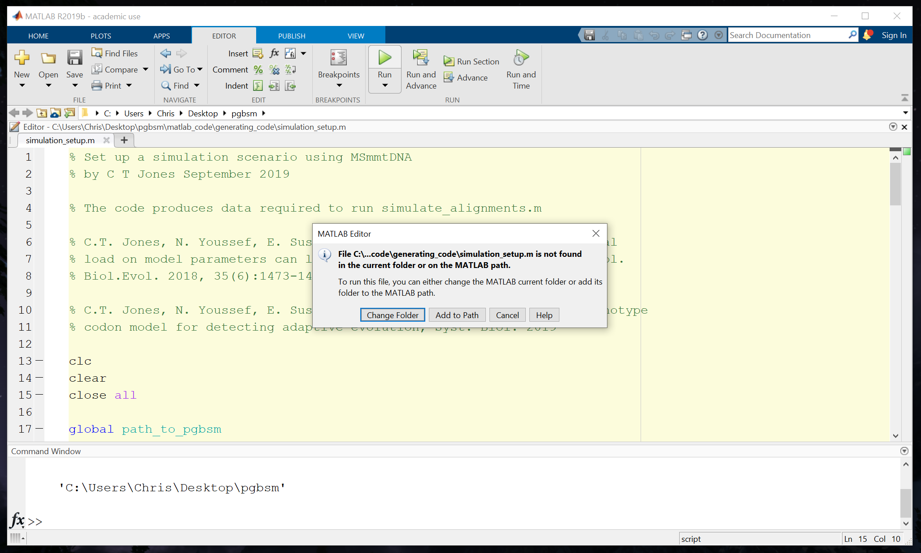
Generating Simulated Alignments
Press the big green triangle to run the script. When you do so a window should open as illustrated below. Click on “Add to Path” to run the code. This will tell Matlab were to find the simulation_setup.m script.
Click on “Add to Path” anytime you this window opens when you attempt to run a script.

Slide 7
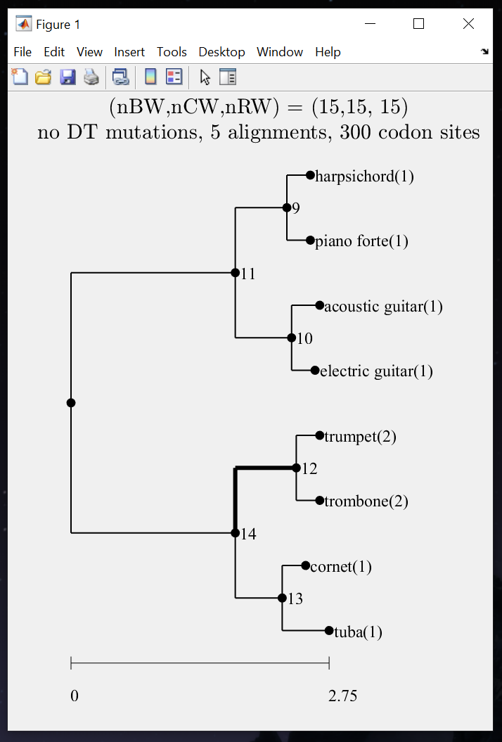
Generating Simulated Alignments
When you run simulation_setup.m, a figure showing a tree will appear. Branches over which some site-specific landscapes change in concert with a change in phenotype are indicated by thicker lines. In this case changes were set to occur over branch 12 only. The phenotype associated with each taxon is indicated by a number. The number 1 corresponds to the phenotype at the root of the tree. The expected number of single nucleotide substitutions per codon site from root to the longest tip is indicate under the tree.
By modifying the appropriate sections of the simulation_setup.m script you can specify the topology and branch lengths of the binary tree, taxon names, the branches over which the phenotype will change, the number of codon sites that will evolve in a way consistent with the CW, RW or BW process (see PG-BSM Concept in the documentation folder), the proportion of double and triple mutations permitted, the number of codon sites in the alignment, and the number of alignments you want to simulate. The following slides show how to change these parameters to suit your needs.

Slide 8
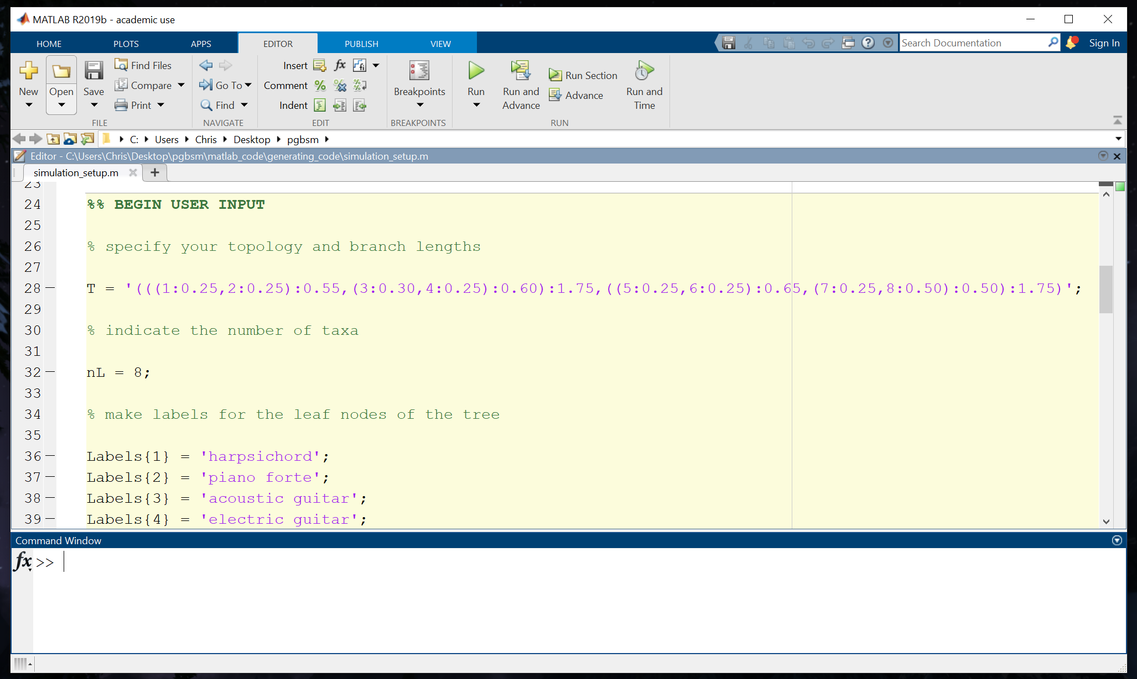
Generating Simulated Alignments
The binary tree is specified in standard nested format with branch lengths indicated after colons. The parameter nL that indicates the number of taxa in the tree must be consistent with the tree T.

Slide 9
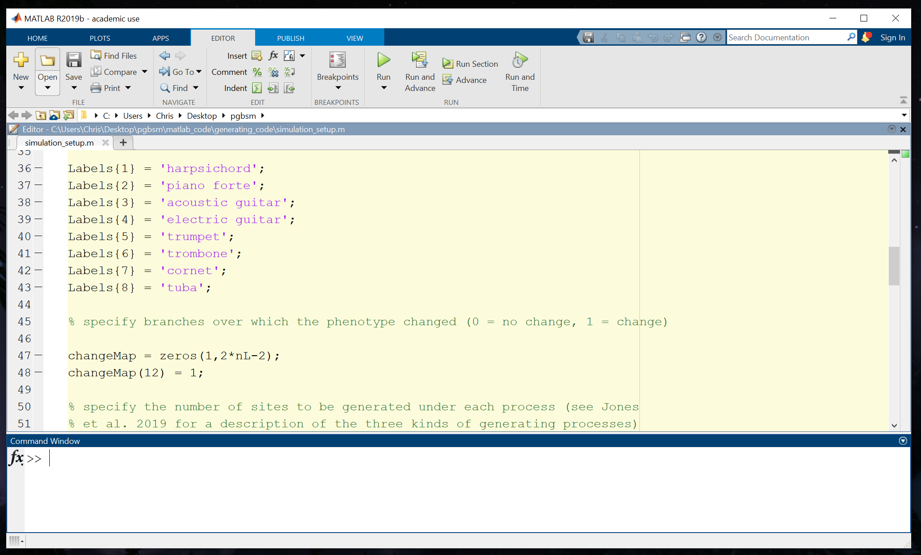
Generating Simulated Alignments
Taxon names should be made to be as simple as possible and should not contain special symbols such as underscores.

Slide 10
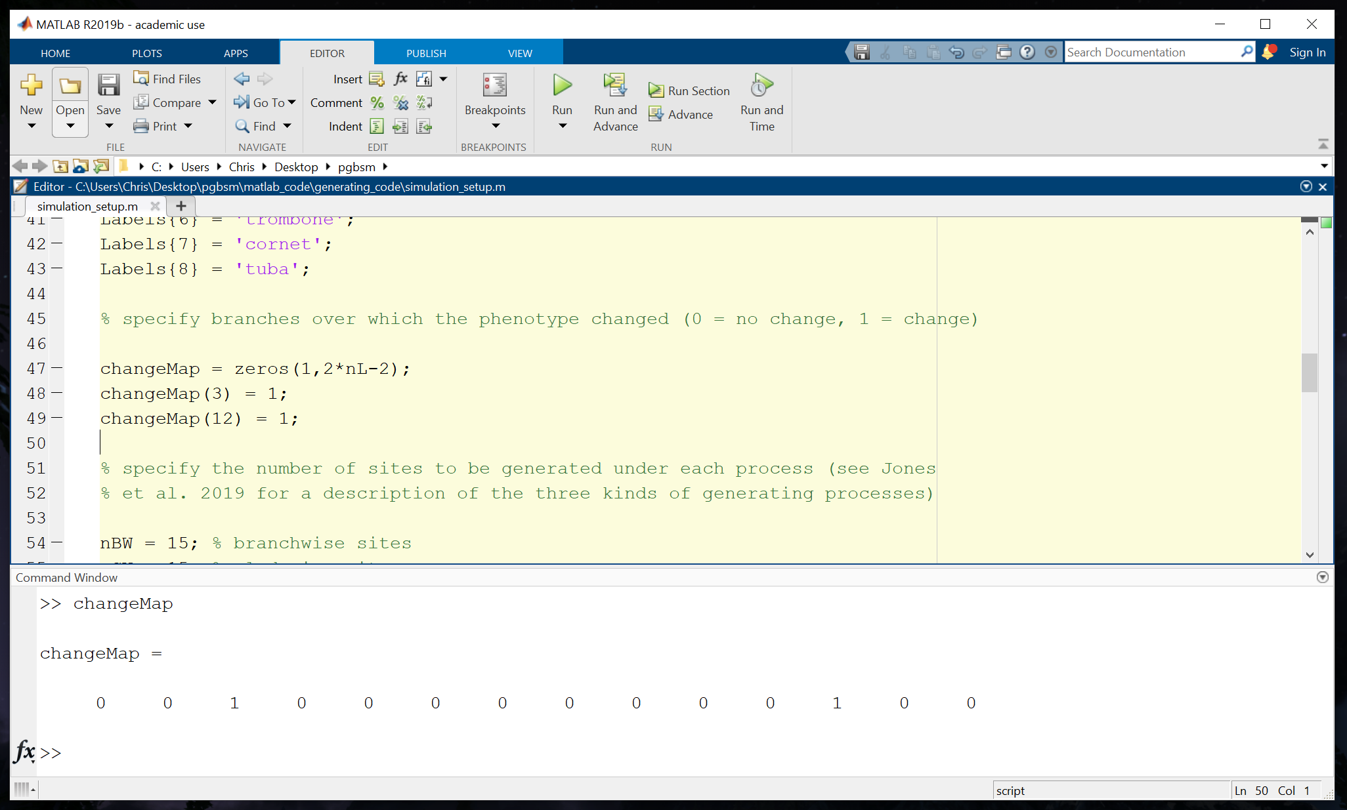
Generating Simulated Alignments
Branches over which the phenotype will change in concert with changes in site-specific landscapes are indicated by the number one in the changeMap vector. Here for example changes will occur along branches 3 and 12.

Slide 11
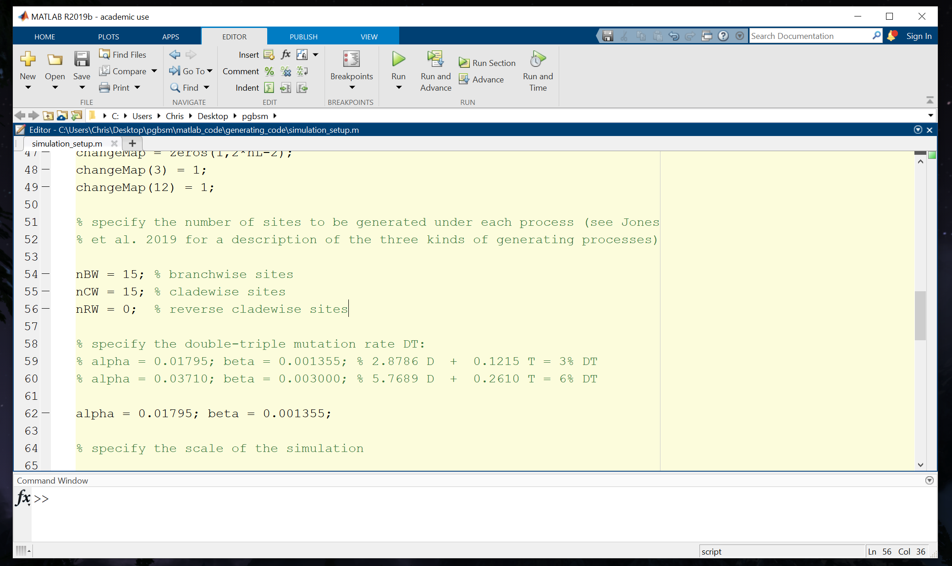
Generating Simulated Alignments
The number of sites that will undergo a cladewise change in the stringency of selection (CW sites), a reverse cladewise change in the stringency of selection (rCW) or a branchwise change corresponding to a site-specific peak shift (BW) should typically be some small fraction of the total number of codon sites.

Slide 12
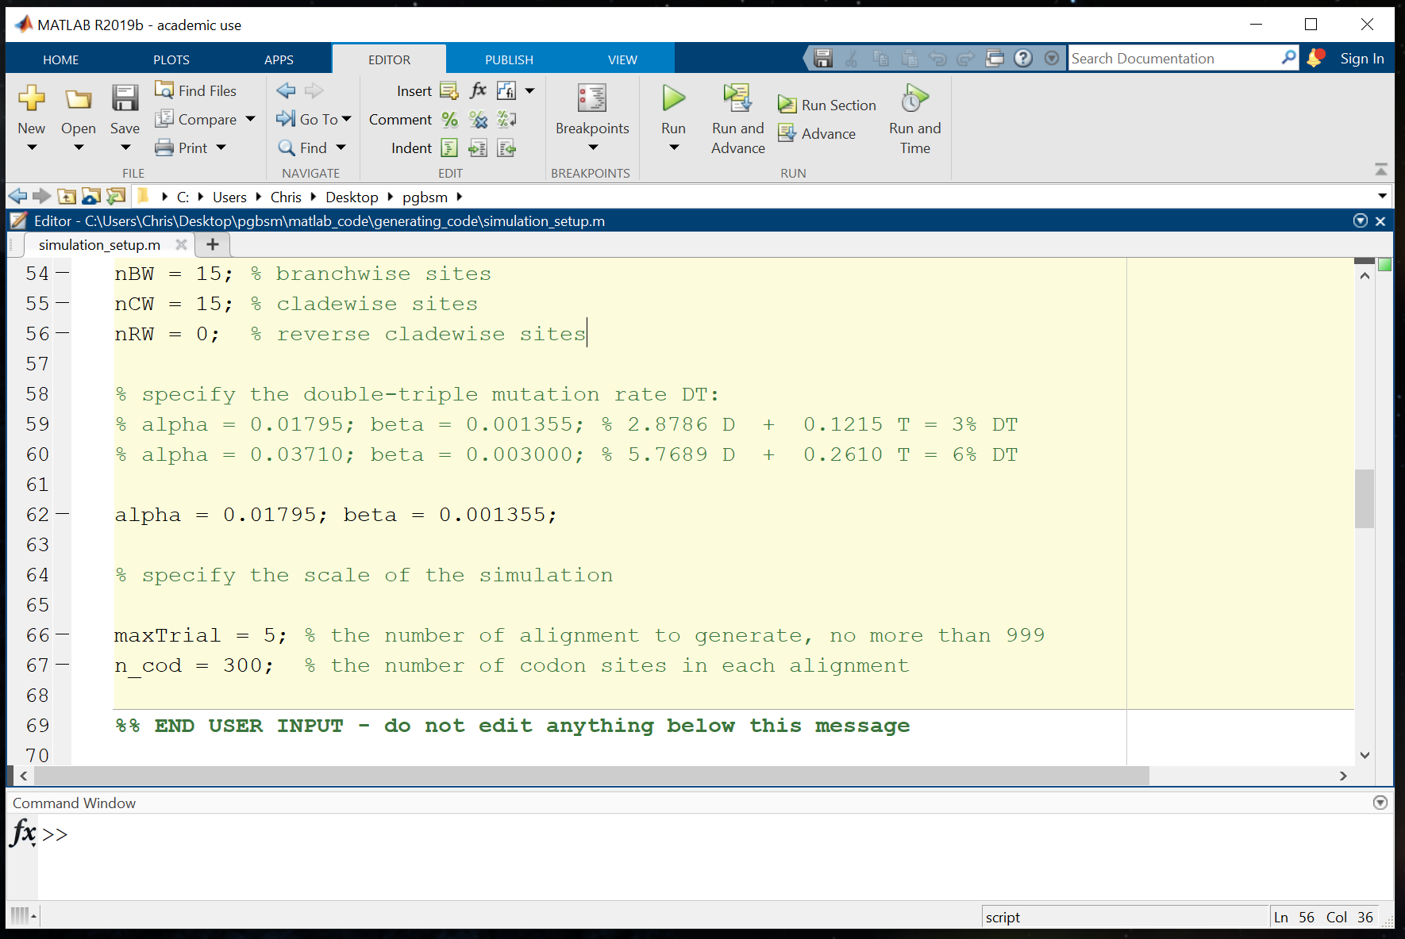
Generating Simulated Alignments
It has been noted that the rate fixation of double and triple mutations (DT mutations) can mislead standard codon substitution model to falsely infer adaptation. The probability of false inference is reduced under the PG-BSM because such event would have to co-occur with a change in phenotype to be detected. This can be tested by including DT mutations in the simulation.
The parameter alpha determines the rate at which double mutations will arise, and beta the rate at which triple mutations will arise.
Two settings are indicated that correspond to a total of 3% or 6% DT mutations. Current estimates of the DT mutation rate are close to 1% (see Jones et al. 2020 for citations).

Slide 13
Generating Simulated Alignments
The number of alignments generated is indicated by maxTrial and the number of codons sites in each alignment by n_cod.

Slide 14
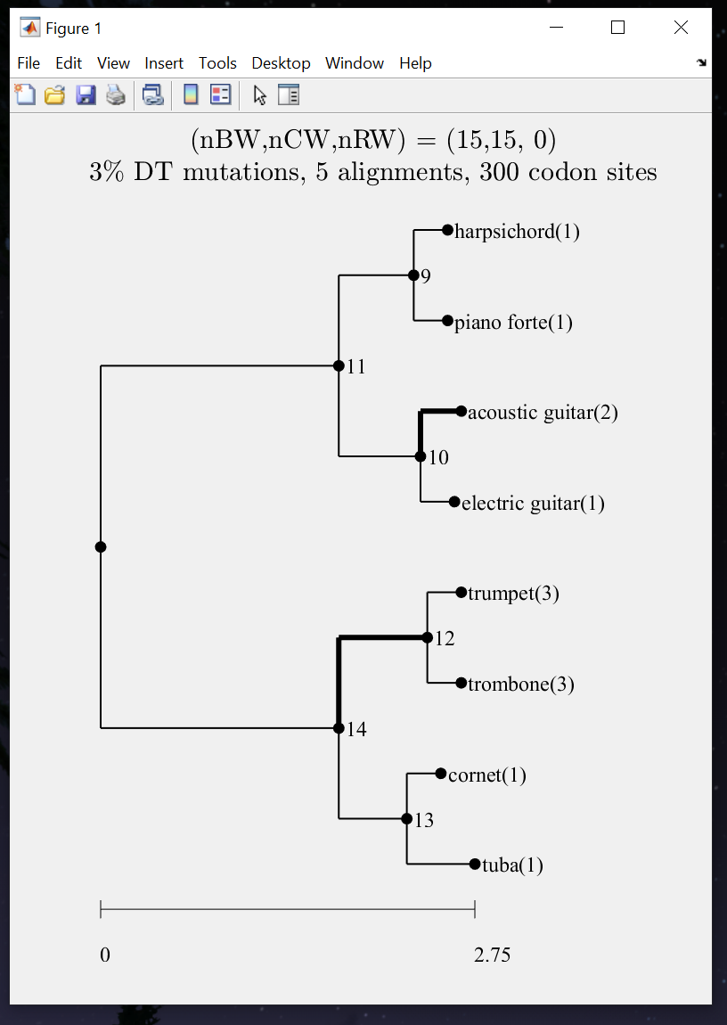
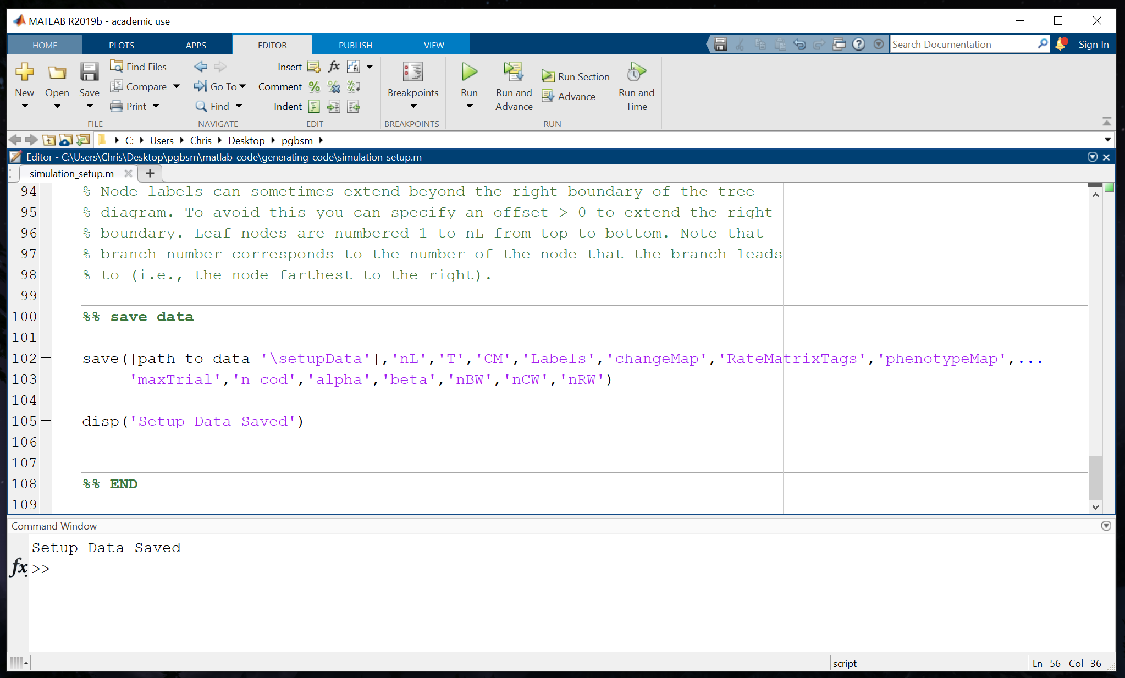
Generating Simulated Alignments
Running simulation_setup.m automatically generates and saves all the information required for your simulation and produces a figure of your tree. The saved information is used when you run the script simulate_alignments.m.

Slide 15
Generating Simulated Alignments
Now to generate your alignments open the script simulate_alignments.m.

Slide 16
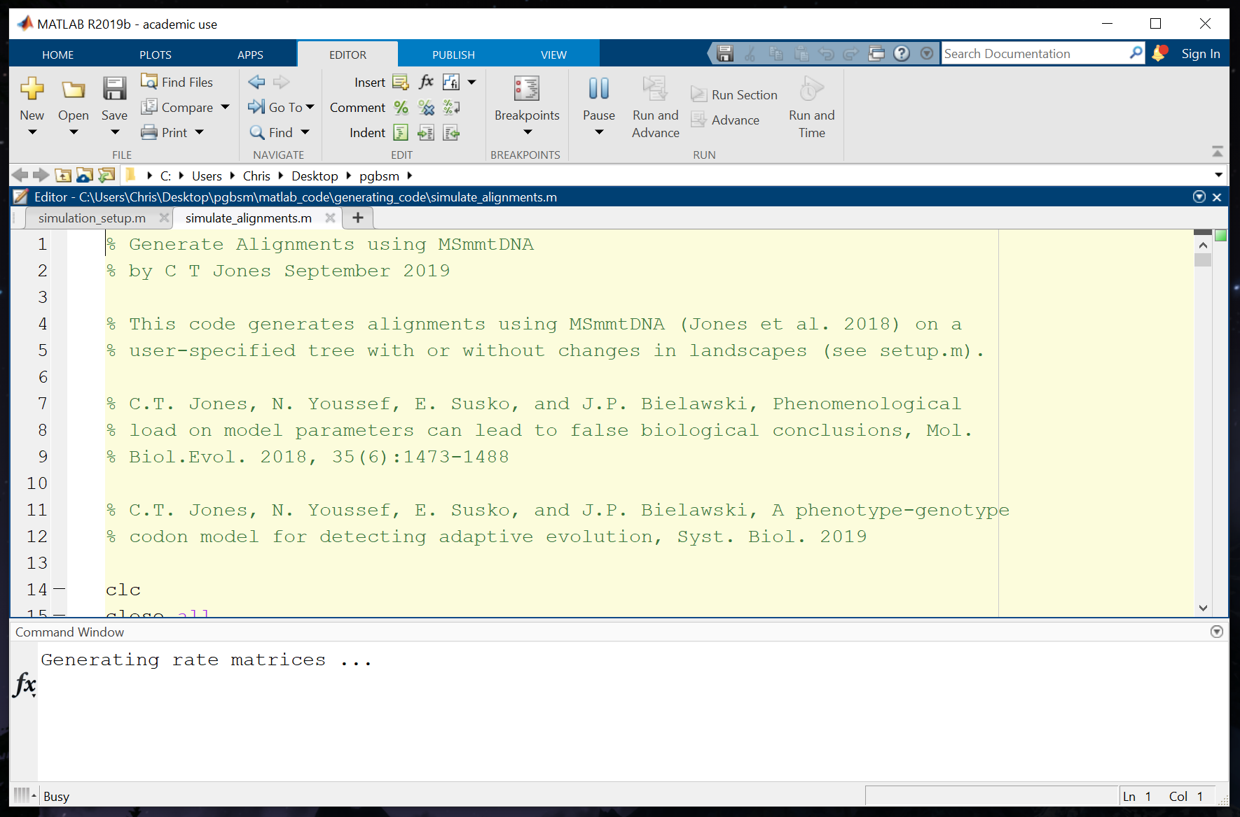
Generating Simulated Alignments
Press the big green triangle to run the script. The code will take some time to run so be patient.

Slide 17
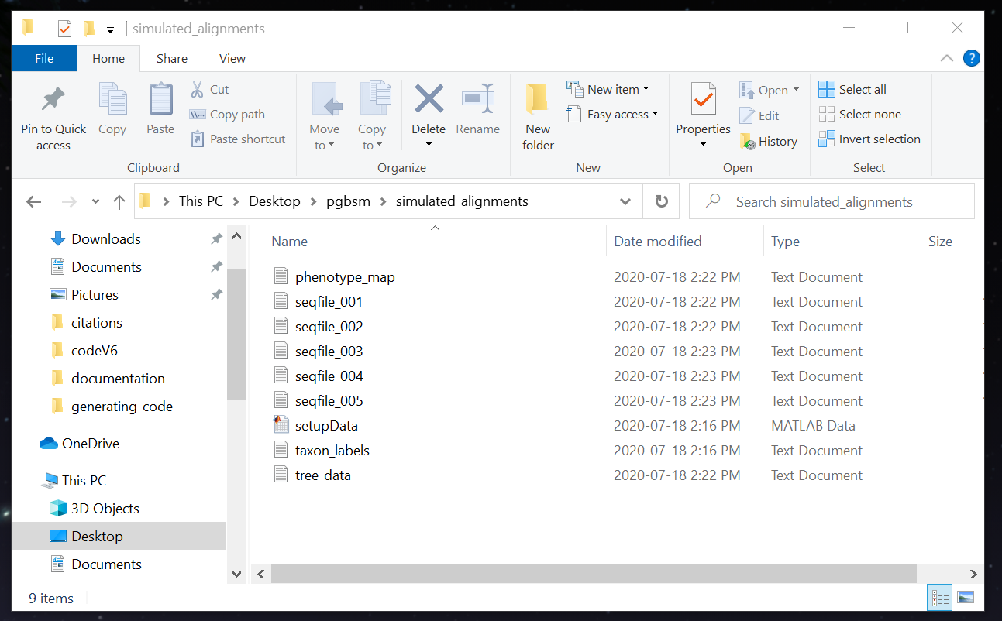
Generating Simulated Alignments
Once its done look in the simulated_alignments folder. There you will find your sequences plus text files that are required for the script that fits the PG-BSM to the data. These include the phenotype_map, taxon_labels, and tree_data.

Slide 18
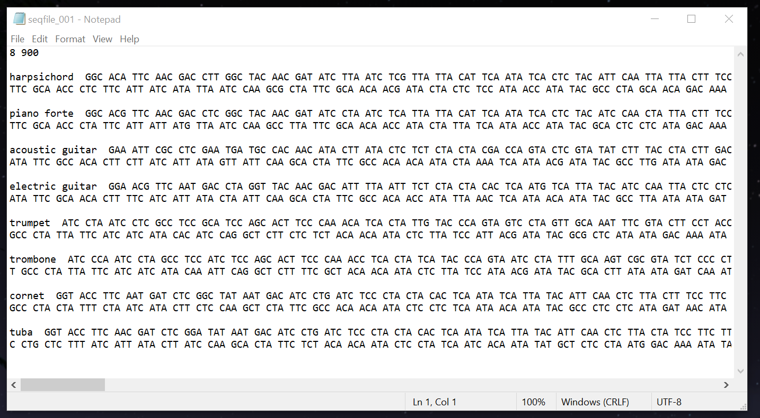
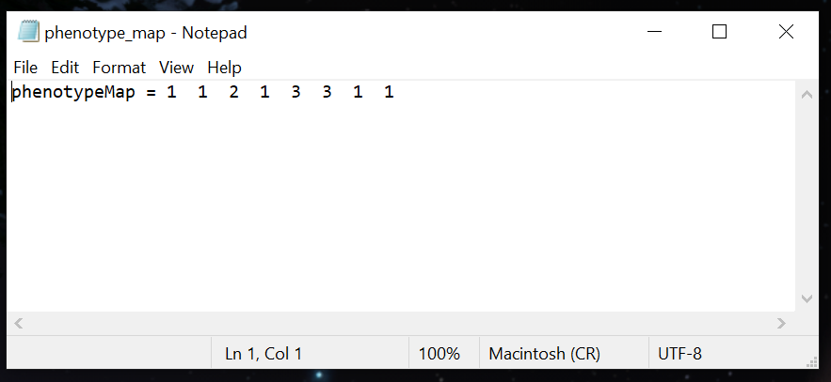
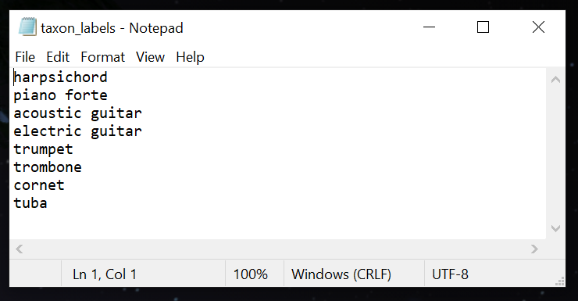
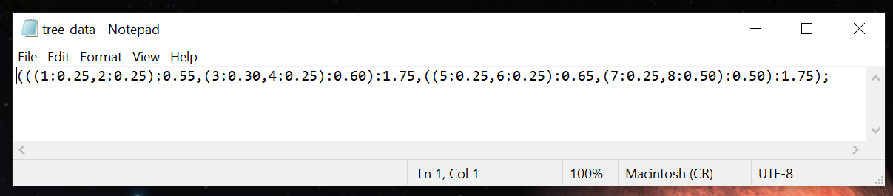
Generating Simulated Alignments
The text files should look like these:

Slide 19
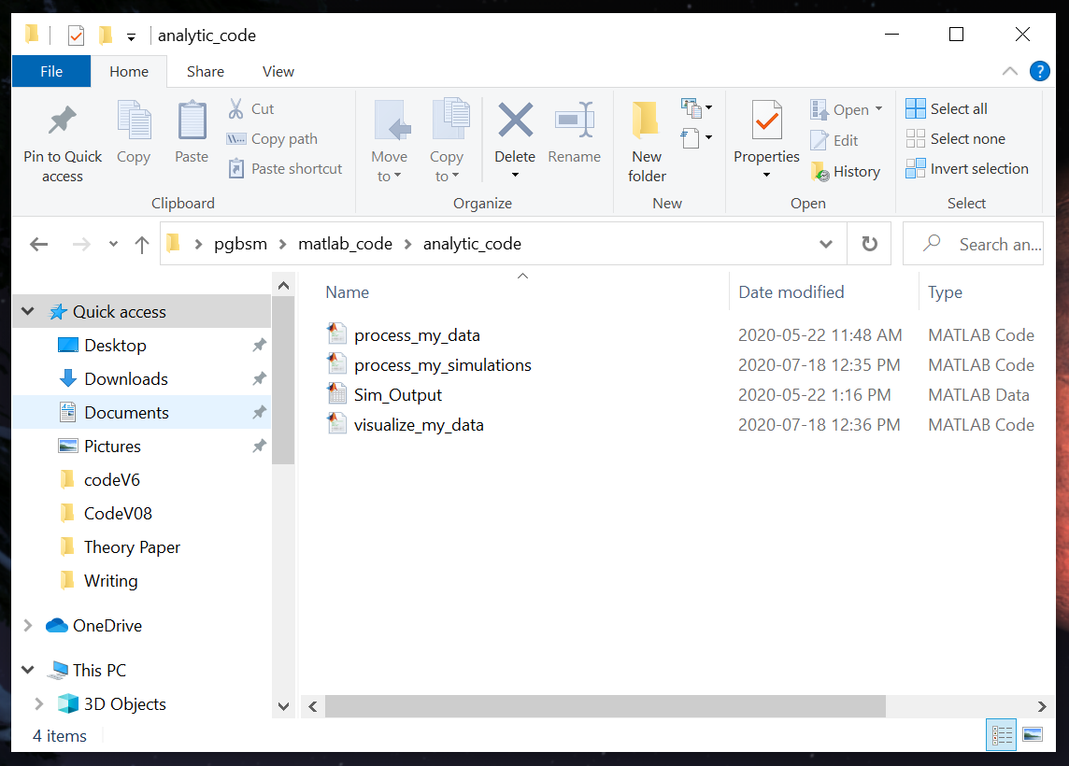
Processing Simulated Alignments
Now let us fit the simulated alignments to the models.
Go into your pgbsm folder and find the folder called analytic_code.

Slide 20
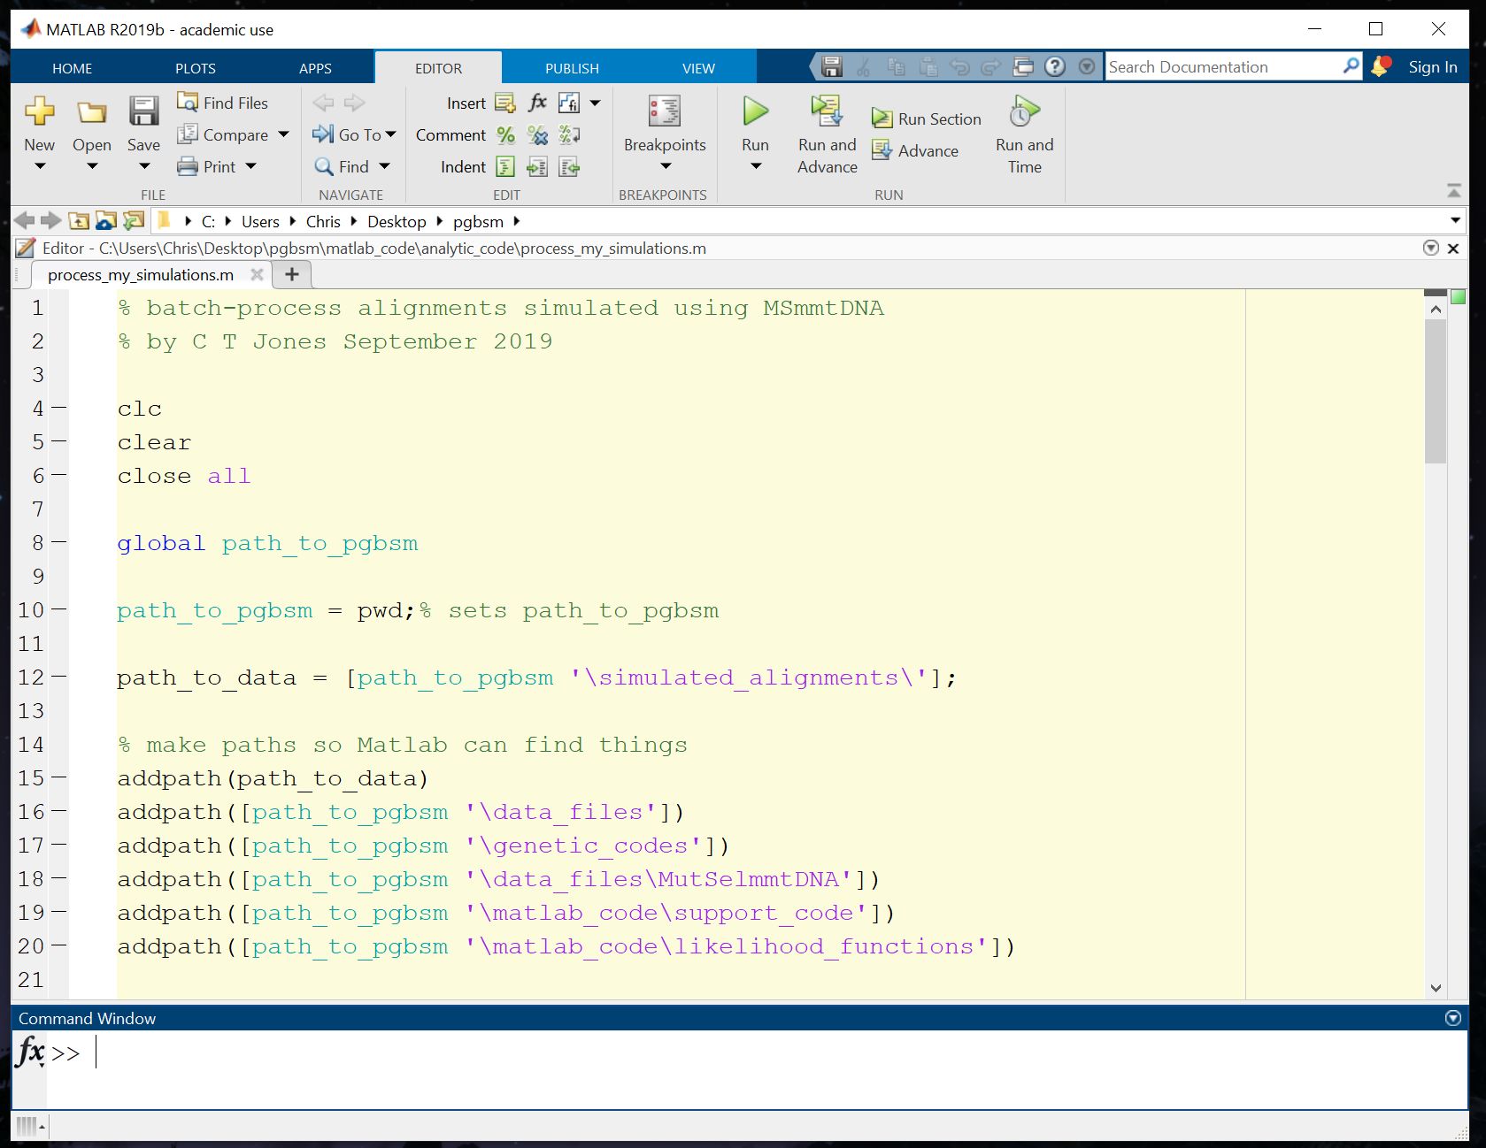
Processing Simulated Alignments
Right click on the Matlab script process_my_simulations.m to open it in your Matlab window. Press Run to get the code started. Note it can take a while for the code to complete, especially for larger alignments.

Slide 21
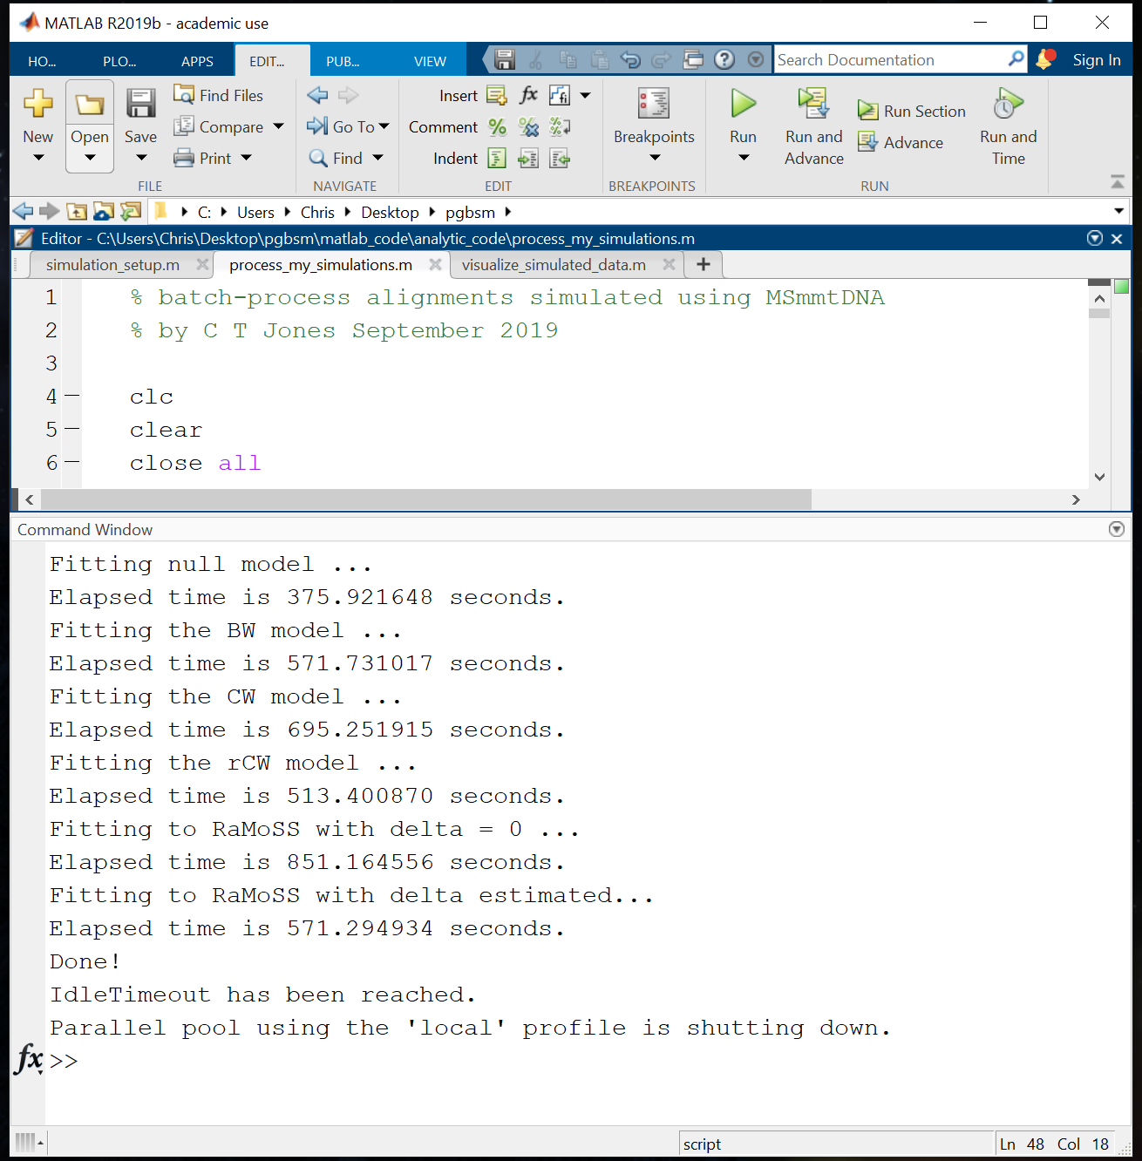
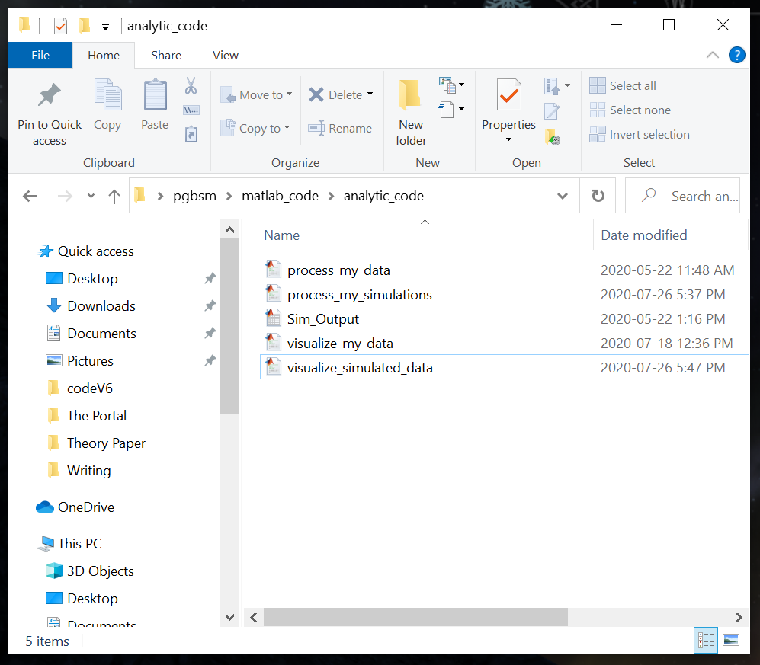
Visualizing Your Results
Once the code has run its time to look at the results.
Right click on the Matlab script visualize_simulated_data.m to open it in your Matlab window.

Slide 22
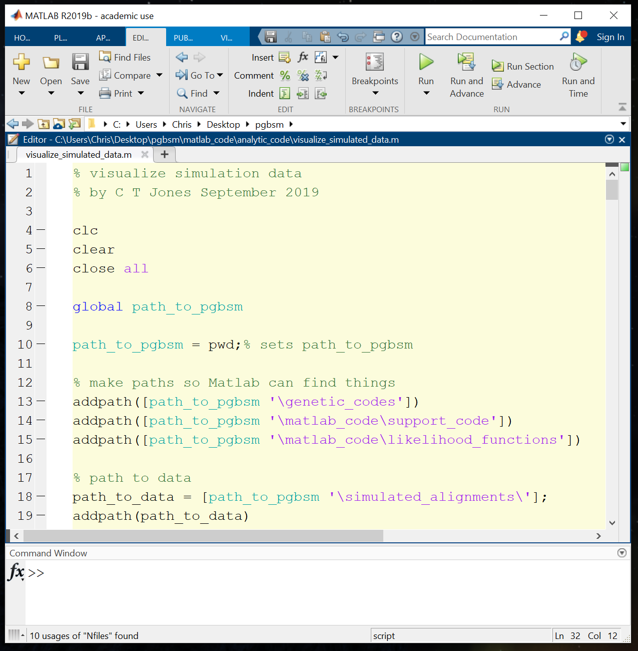
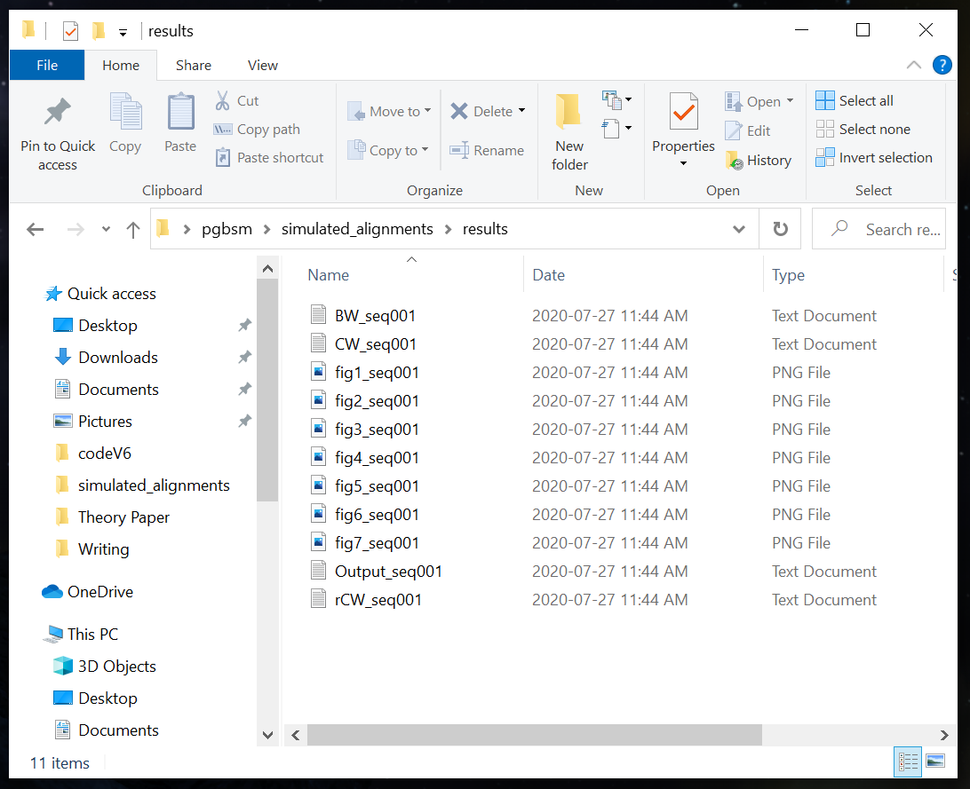
Visualizing Your Results
Click on run. The code will generate seven figures and four text files that will all appear in the results folder.

Slide 23
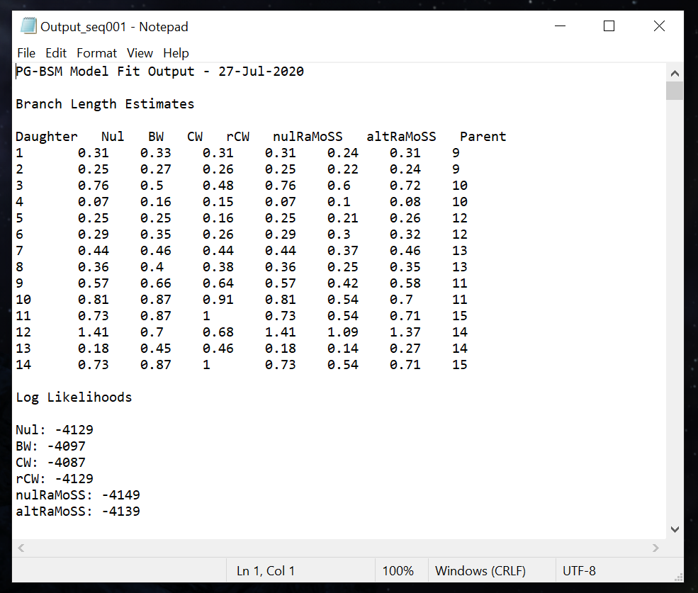
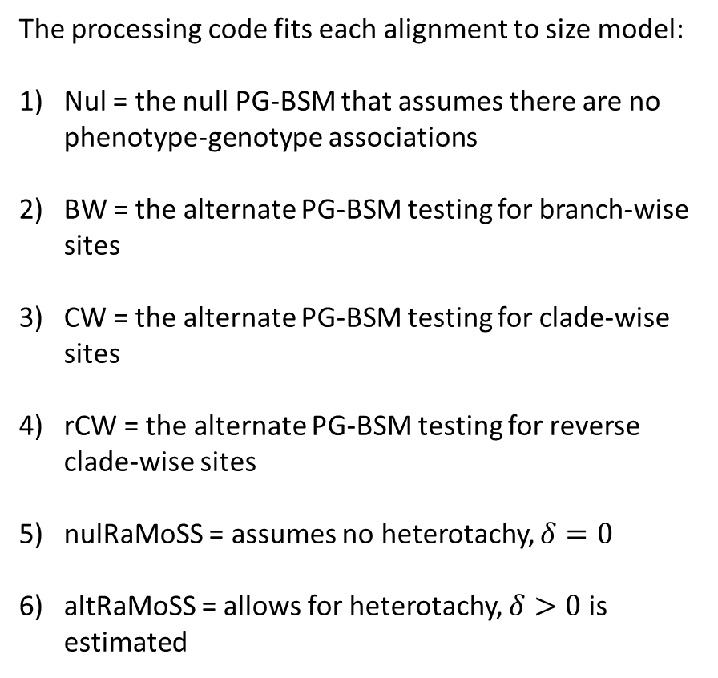
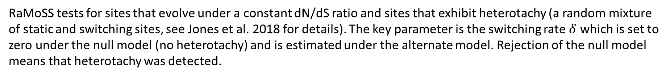
Interpreting Your Results
The processing code fits each alignment to size model:
Nul = the null PG-BSM that assumes there are no phenotype-genotype associations
BW = the alternate PG-BSM testing for branch-wise sites
CW = the alternate PG-BSM testing for clade-wise sites
rCW = the alternate PG-BSM testing for reverse clade-wise sites
nulRaMoSS = assumes no heterotachy, $δ=0$
altRaMoSS = allows for heterotachy, $δ>0$ is estimated
RaMoSS tests for sites that evolve under a constant dN/dS ratio and sites that exhibit heterotachy (a random mixture of static and switching sites, see Jones et al. 2018 for details). The key parameter is the switching rate $δ$ which is set to zero under the null model (no heterotachy) and is estimated under the alternate model. Rejection of the null model means that heterotachy was detected.

Slide 24
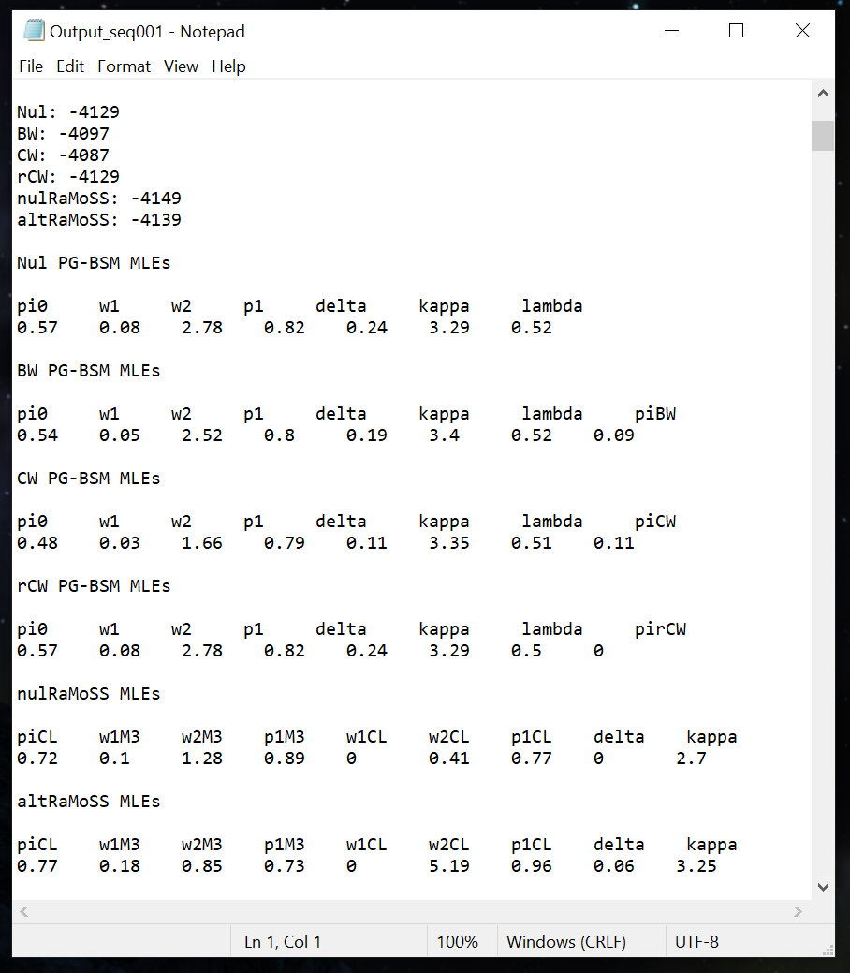
Interpreting Your Results
The alternate RaMoSS model fits better than its counterpart null model, indicating the detection of heterotachous sites. The estimated proportion of such sites is 77%.
Most of these sites are not associated with phenotype, meaning that their site patterns are not consistent with changes in dN/dS that correspond to changes in phenotype.
The PG-BSM indicates that 11% and 9% of sites exhibit heterotachy consistent with the CW and BW process, respectively. This illustrates how the PG-BSM can be used to identify from a set of site patterns that exhibit heterotachy-by-any-cause those with specific patterns of heterotachy consistent with changes in site-specific landscapes that are inferred to have co-occurred with changes in phenotype.

Slide 25
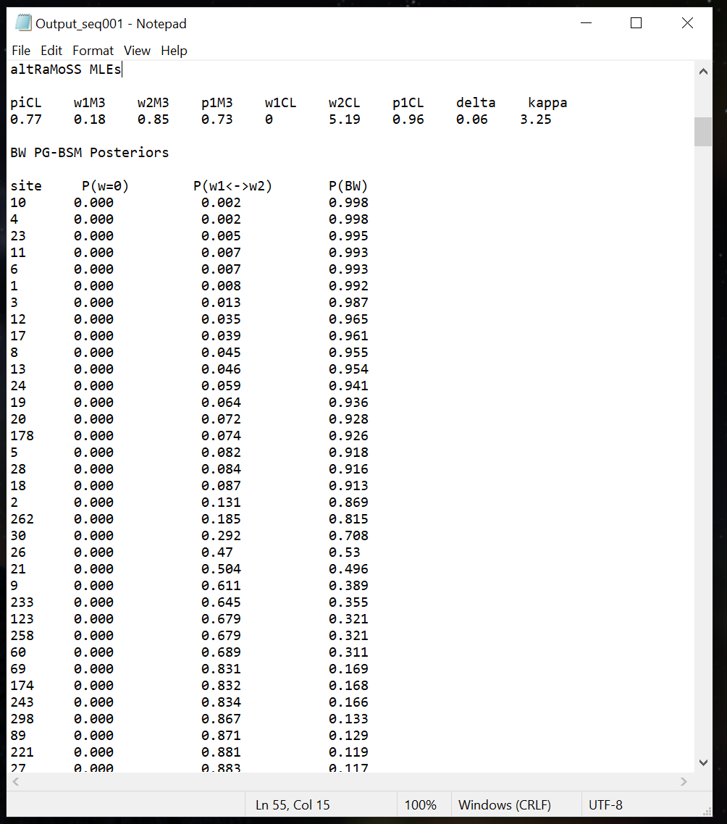
Interpreting Your Results
P(w=0) is the posterior probability that the site is fixed.
P(w1 <-> w2) is the posterior probability that the site is heterotachous but not consistent with the BW process.
P(BW) is the posterior that the site is consistent with the BW process.
In this case the data was generated with sites 1 to 15 under the BW process and 16 to 30 under the CW process. There are 11 sites with P(BW) > 0.95. All of these are among the first 30 sites and 9 are among the first 15. Hence, 9 BW sites were correctly detected assuming a posterior threshold of 0.95, with 2 false positives that were in fact CW sites.

Slide 26
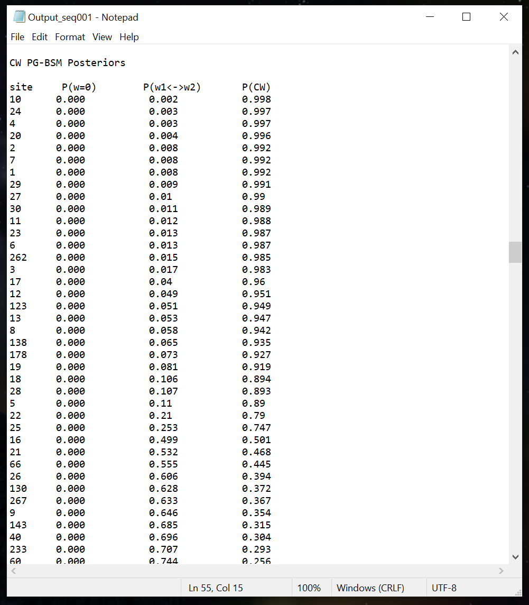
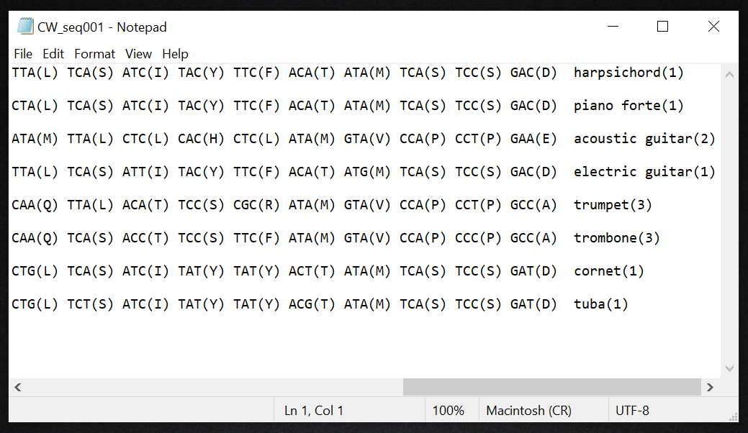
Interpreting Your Results
Here there are 17 sites with P(CW) > 0.95, all of which are among the first 30 sites apart from site 262. Assuming a posterior threshold of 0.95, the model correctly identified 8 CW sites (sites from 16 to 30 with P(CW) > 0.95) with 9 false positives, all but one of which is among the first 30 site patterns.
The site patterns identified by the method used to control the false discover rate (Jones et al.2020) are listed in the files labeled BW_seqxxx, CW_seqxxx, and rCW_seqxxx.

Slide 27
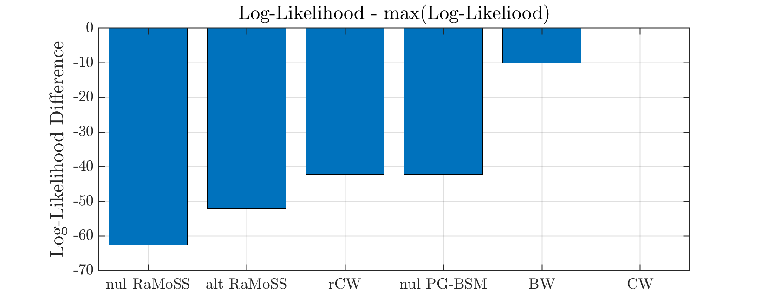
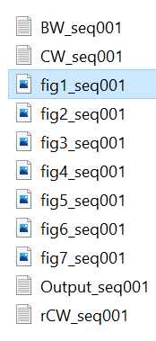
Interpreting Your Results
Results includes 7 figures. Figure 1 illustrates the difference in log-likelihood for each model compared to the best fitting model. These are shown in order from worst to best fit. Here the null RaMoSS model provided the worst fit and the PG-BSM with the CW process provided the best fit.

Slide 28
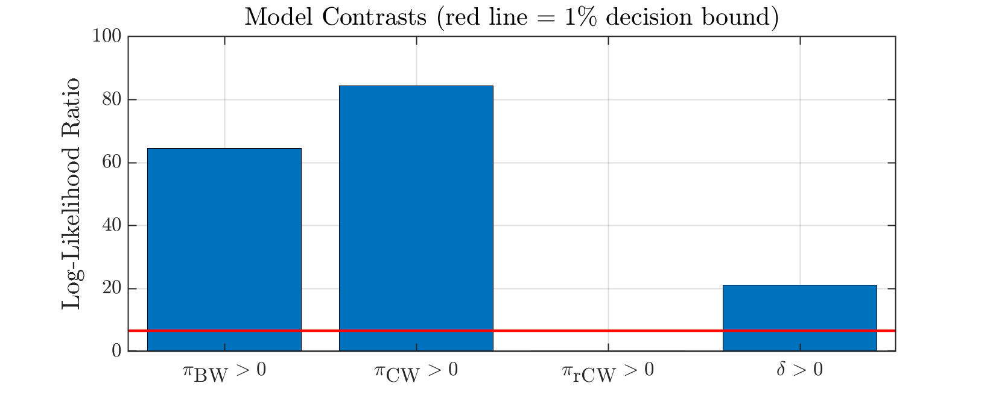
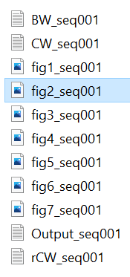
Interpreting Your Results
Figure 2 shows the log-likelihood for the contrast between the null PG-BSM and the PG-BSM with the BW, CW and rCW processes and between the null RaMoSS and alternate RaMoSS. Values above the 1% decision bound indicate that the null should be rejected.

Slide 29
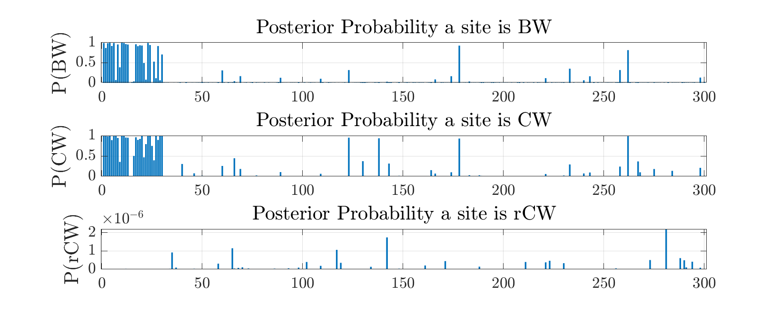
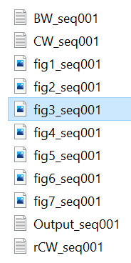
Interpreting Your Results
Figure 3 shows site-specific posterior probabilities. Probabilities closer to one indicates sites whose patterns are more consistent with the respective process, BW, CW, or rCW. Note that the simulation code places all such sites at on left site of the sequence. Here for example sites 1 to 15 were evolved under the BW process and sites 16 to 30 under the CW process. In this case the results suggest that the model cannot easily distinguish between the two.

Slide 30
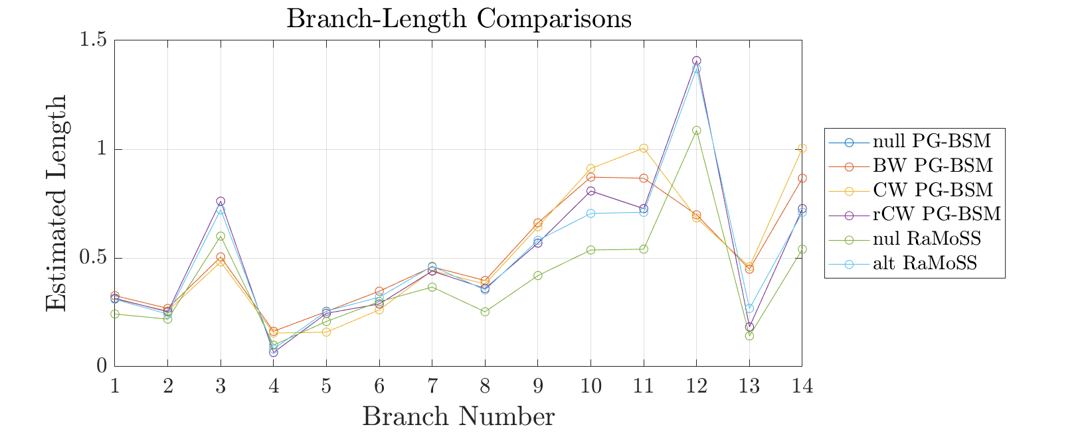
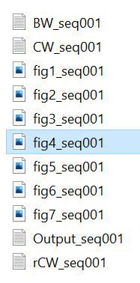
Interpreting Your Results
Figure 4 compares branch-length estimates. Non-stationarity (i.e., changes in some site-specific landscapes) is indicated when the estimate of a branch length is substantially smaller under one of the alternate PG-BSM models than it is under the other models (e.g., branch 12).

Slide 31
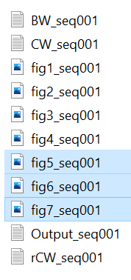
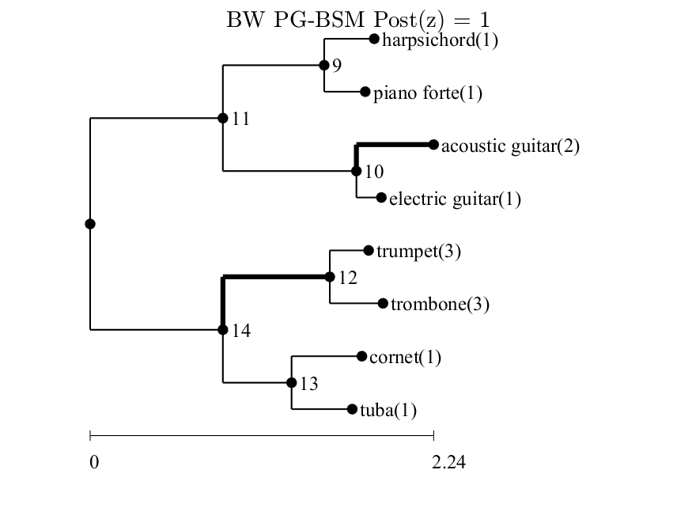
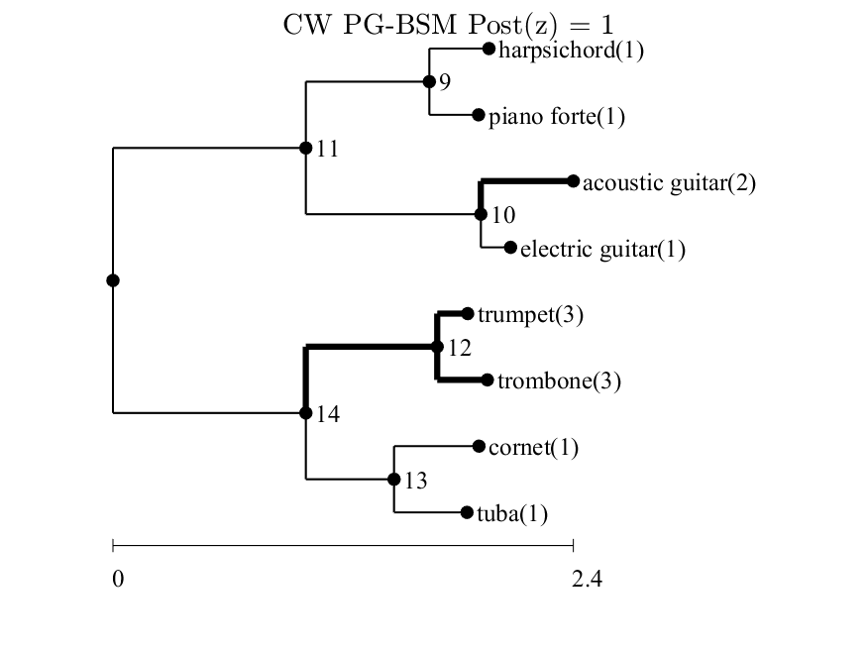
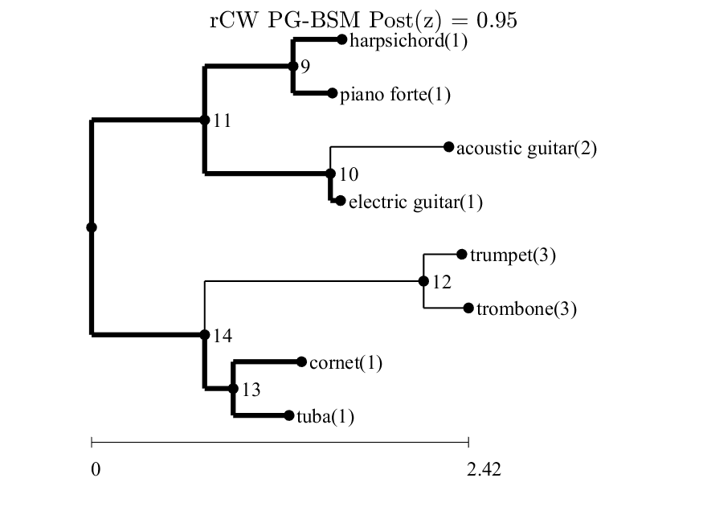
Interpreting Your Results
Figures 5 to 7 illustrate the branches over which the phenotype is most likely to have changed (i.e., the change map z). The posterior probability that z is the correct pattern of change is given by Post(z) (see Jones et al. 2020 for details). In this case all three versions of the alternate PG-BSM correctly identified branches 3 and 12 as those over which the phenotype changed in coordination with changes in some site-specific landscapes.

Slide 32
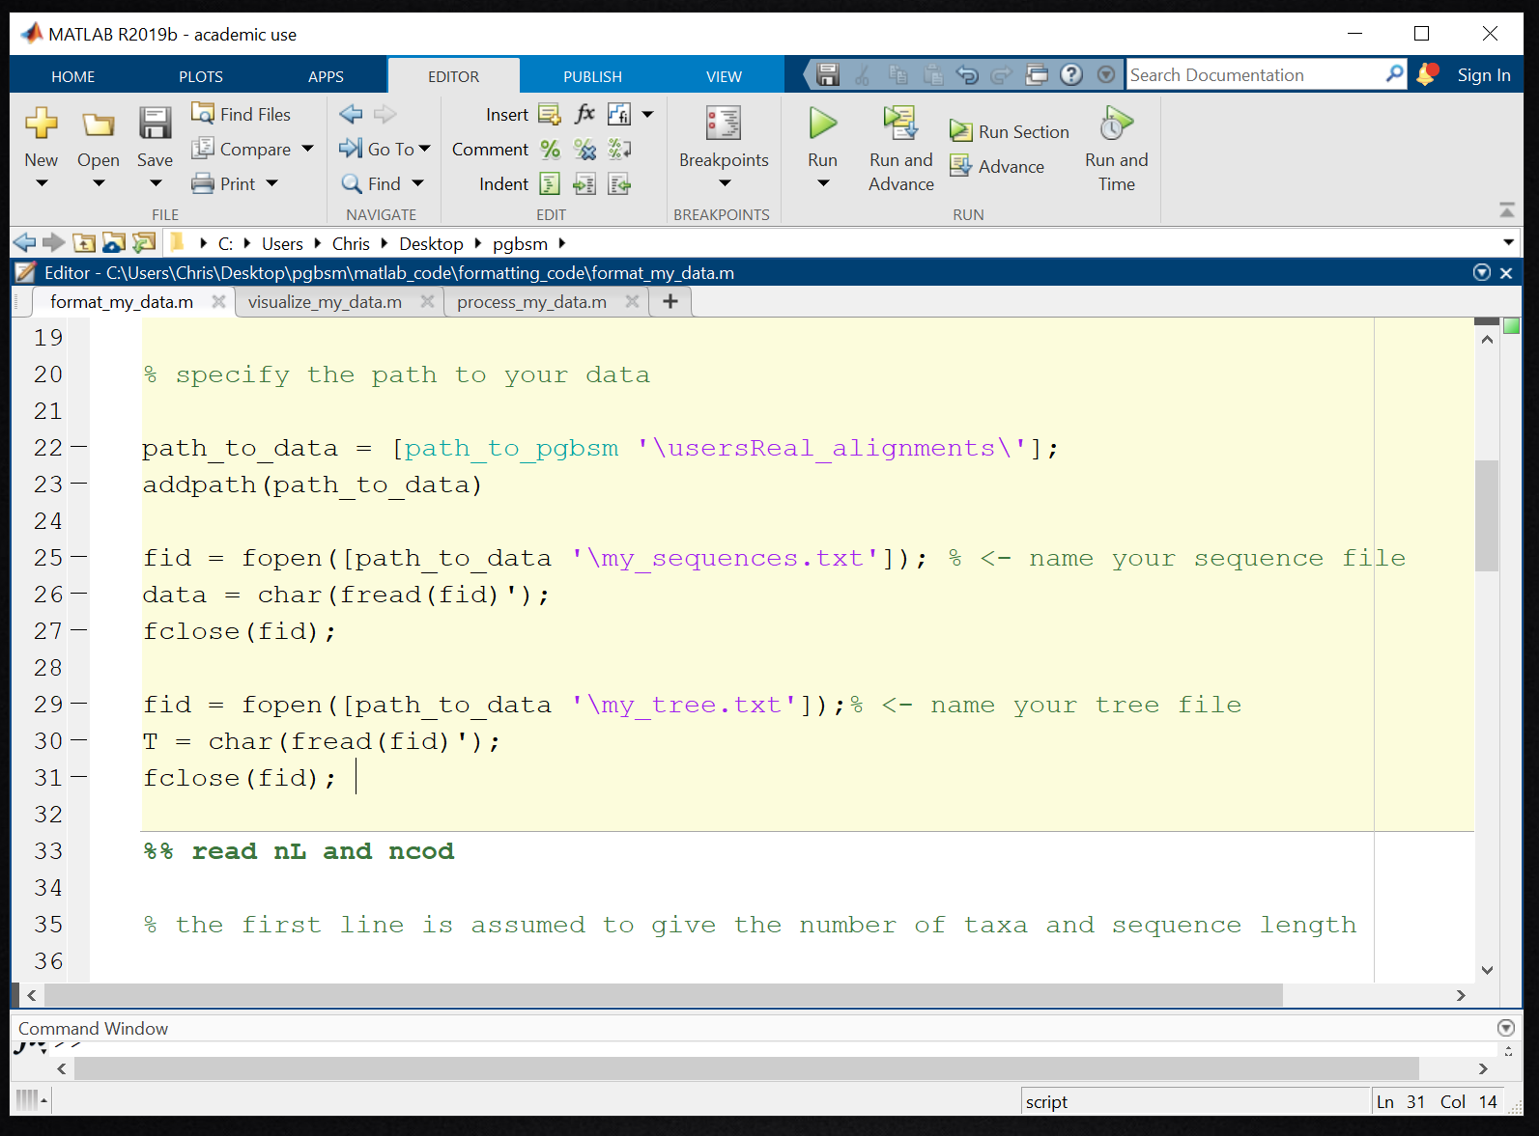
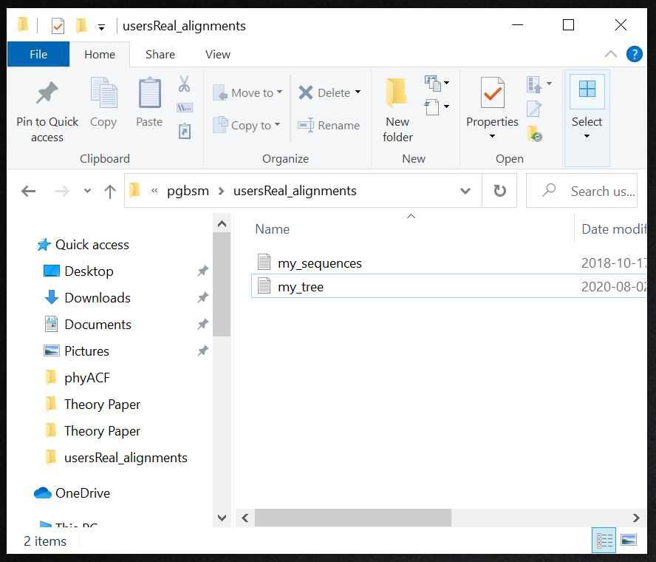
Processing your own Data
This section shows how to adjust your own data to conform to the format assumed by the PG-BSM code.
First place the data file containing your sequences and a file containing your tree into the director usersReal_sequences. In this example the sequence file is called my_sequences.txt and the tree file my_tree.txt. You can name these anything you like, but the same names must appear in the Matlab script format_my_data.m as shown on below on the right.

Slide 33
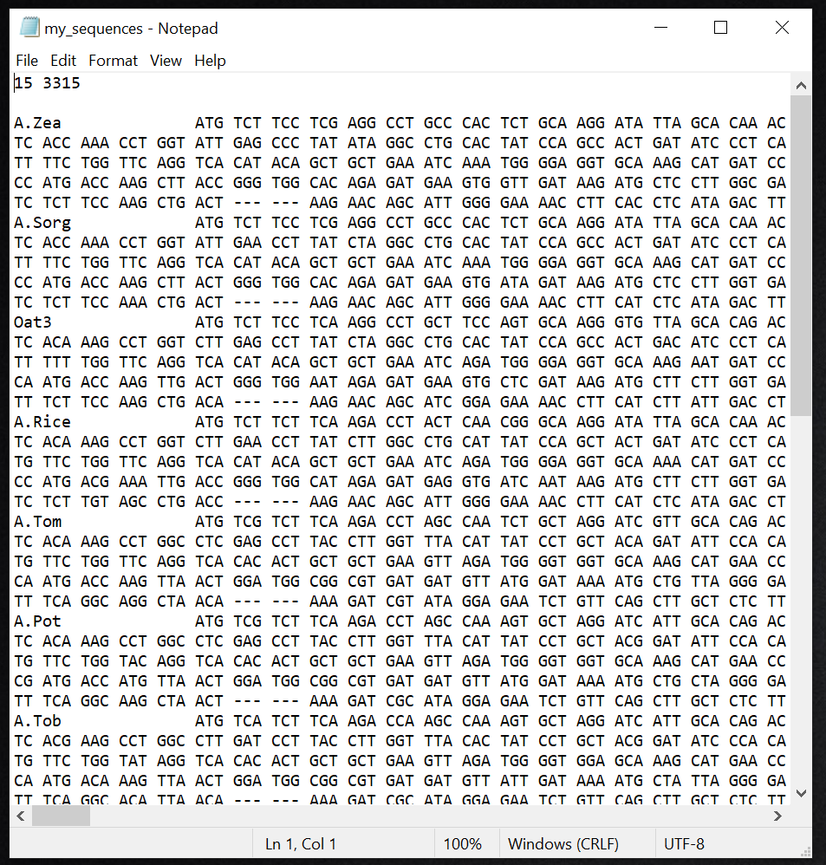
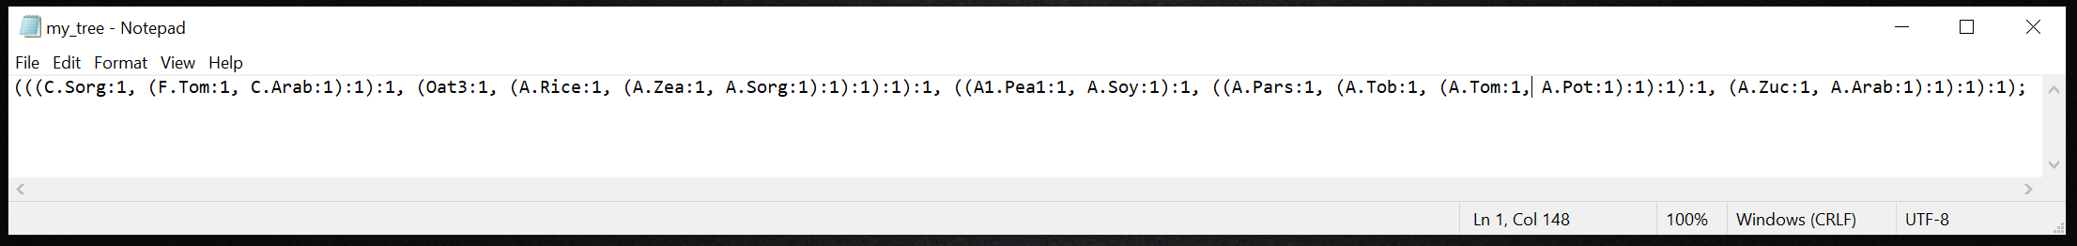
Processing your own Data
In this case the alignment consists of 15 angiosperm phytochrome sequences. (Yang and Nielsen, 2002; Zhang et al., 2005). Note that the code will only work with a rooted tree. The tree must also include branch lengths that serve as initial estimates for the optimization. If none are available, then insert dummy branch lengths as shown below.
Note that missing codons must be indicated by “---” as shown here on the left. When the data is processed, any site pattern with at least one missing codon will be removed from the alignment.

Slide 34
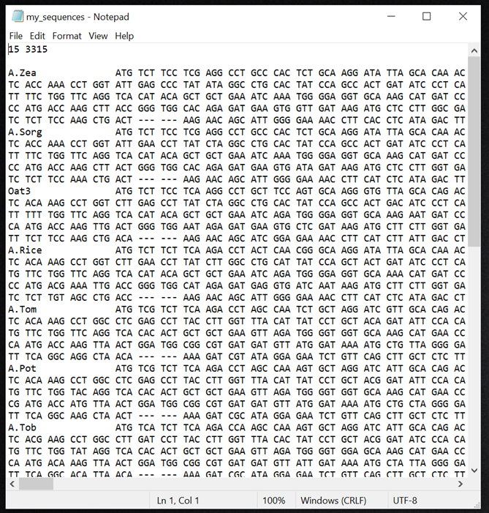
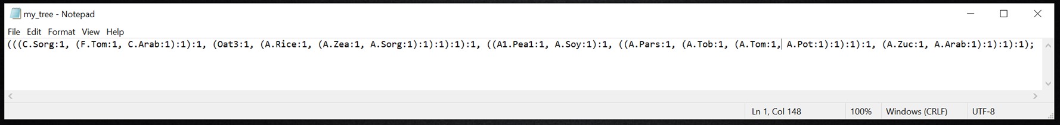
Processing your own Data
The PG-BSM code assumes that sequences are listed in the same order that they appear in the tree. In this case the first sequence A.Zea does not match the first taxon C.Sorg in the tree file. If the sequence file and tree file are correctly formatted (i.e., they look like what is shown here), then you can run format_my_data.m to arrange the sequences in proper order.

Slide 35
Processing your own Data
The script format_my_data.m will arrange the sequences in proper order and replace taxon names with numbers.
Before running the format_my_data.m script make sure the names of your sequence file and tree file in usersReal_alignments match what is in the Matlab script.

Slide 36
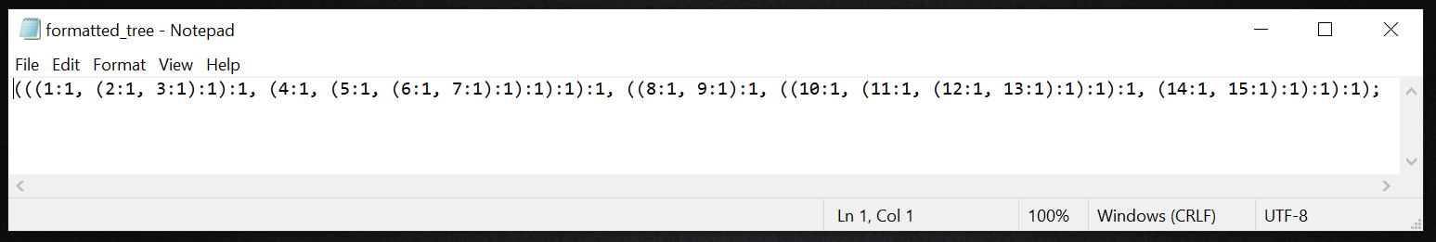



Processing your own Data
Running format_my_data.m creates the three files shown below. The processing code will make use of these files to fit the models to your data.

Slide 37



Processing your own Data
The last step before processing you will need to make a phenotype_map.txt file to indicate the phenotype of each taxon using integer indicators starting from zero. In this case the sequences are partitioned into two phenotypes, phyA and phyC + phyF as shown in the tree below.

Slide 38


Processing your own Data
Now open process_my_data.m and make sure that the file names in the script are the same as the file names in usersReal_alignments. You will also need to select the correct genetic code for your data. Once all this is set press the green triangle to run the code. Processing can a fair amount of time (i.e., more than an hour) depending on the size of your data set.

Slide 39


Visualizing Your Results
Right click on the Matlab script visualize_my_data.m to open it in your Matlab window. Be sure all the file names are correct before running the code. You can assign a tag to the output files to help organize the outputs for multiple data sets.

Slide 40



Visualizing Your Results
In this case the PG-BSM in any of its forms did not provide as good a fit to the data as the alternate RaMoSS model. Hence, whereas there is significant evidence of heterotachy at more than half of the sites in the alignment (the estimated proportion of covarion-like sites was piCL = 0.63 or 63% of sites – see Jones et al. 2018 for a full description of RaMoSS), there was no evidence for the particular modes of heterotachy tested for by the PG-BSM (i.e., no BW, CW, or rCW sites).

Slide 41


Interpreting Your Results
Failure to reject the null PG-BSM suggests that none of the non-stationary BW, CW and rCW processes under which a subset of sites undergo changes in their site-specific landscapes along branches over which the phenotype changed (see the PG-BSM Concept slide show for details) had occurred. This is consistent with the negligible difference in branch-length estimates under the null and alternate PG-BSM as shown here (cf. slide 30).
The covarion-like (CL) component of the null PG-BSM and the alternate RaMoSS captures random changes in site-specific rate ratios (heterotachy-by-any-cause, see the PG-BSM Concept slide show for details), which is a stationary process. Rejection of the null RaMoSS in this case demonstrates heterotachy in the data, whereas failure to reject the null PG-BSM demonstrates that the heterotachy is consistent with the stationary CL process. The non-stationary BW, CW and rCW processes are not required to explain the data in this case.

Slide 42
Fin Users Tutorial Version 1.00
By C T Jones, May 2020
cjones2@dal.ca

